Slide 1

Sets, Combinatorics, and Probability
Mathematical Structures for Computer Science
Chapter 4
Copyright © 2014 W.H. Freeman & Co. MSCS Slides Section 4.2

Slide 2
Counting
The idea is to find out how many members are present in a finite set. Principles of counting answer the following kind of questions:
  How many four digit numbers can there be if repetition of numbers is allowed and if repetition of numbers is not allowed?
  If a man has 4 suits, 8 shirts and 5 ties, how many outfits can he put together?
Multiplication Principle: If there are n possible outcomes for a first event and m possible outcomes for a second event, then there are n.m possible outcomes for the sequence of the two events.
Hence, from the multiplication principle, it follows that for two sets A and B
|A×B| = |A|.|B|
A child is allowed to choose one jellybean out of two jellybeans, one red and one black, and one gummy bear out of three gummy bears, yellow, green, and white. How many different sets of candy can the child have?
|A| = ?
Answer is the number of members in Set A
Section 4.2
Counting

Slide 3
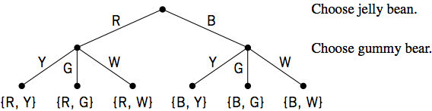
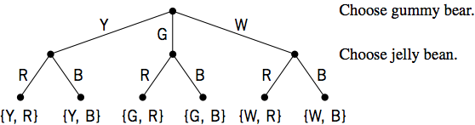
Example: Multiplication Principle
There are 2×3=6 or 3×2=6 possible outcomes as seen from the following figures
Section 4.2
Counting

Slide 4
Addition Principle
Addition Principle: If A and B are disjoint events with n and m outcomes, respectively, then the total number of possible outcomes for event “A or B” is n+m.
If A and B are disjoint sets, then |A ∪ B| = |A| + |B| using the addition principle.
Prove that if A and B are finite sets then
|A-B| = |A| - |A ∩ B| and |A-B| = |A| - |B| if B ⊆ A
  (A-B) ∪ (A ∩ B) = (A ∩ B′) ∪ (A ∩ B)
  = A ∩ (B′ ∪ B)
  = A ∩ U
  = A
Also, A-B and A ∩ B are disjoint sets, therefore using the addition principle
  |A| = | (A-B) ∪ (A ∩ B) | = |A-B| + |A ∩ B|
Hence, |A-B| = |A| - |A ∩ B|
If B ⊆ A, then A ∩ B = B
Hence, |A-B| = |A| - |B|
Note: Set A-B consist of elements in A not in B: Set Difference
Note: |A-B| is the number of elements in A not in B
All elements not in set B in union with all elements in Set B
Universal Set
If A is a subset of B, we denote the relationship by A ⊆ B. If A ⊆ B but A ≠ B (there is at least one element of B that is not an element of A), then A is a proper subset of B, denoted by A⸦B.
Denotes subset
Section 4.2
Counting

Slide 5
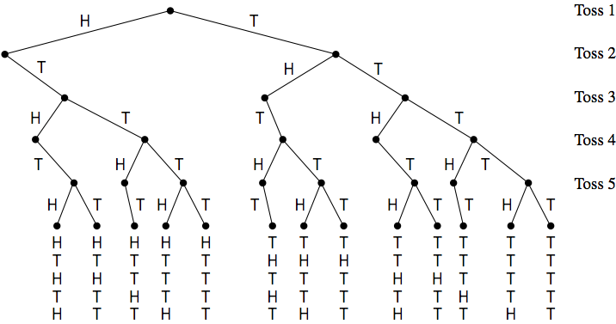
Decision trees
Trees that provide the number of outcomes of an event based on a series of possible choices are called decision trees.
Tony is pitching pennies. Each toss results in heads (H) or tails (T). How many ways can he toss the coin five times without having two heads in a row?
There are 13 possible outcomes as seen from the tree.
Section 4.2
Counting

